Slide 1

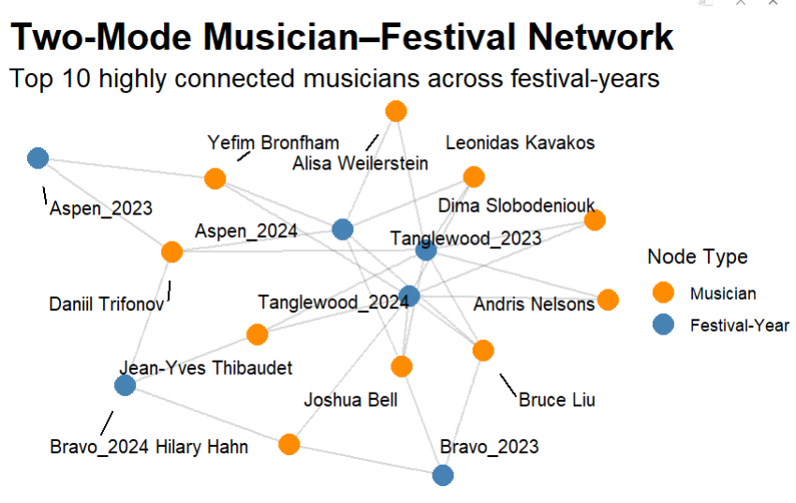
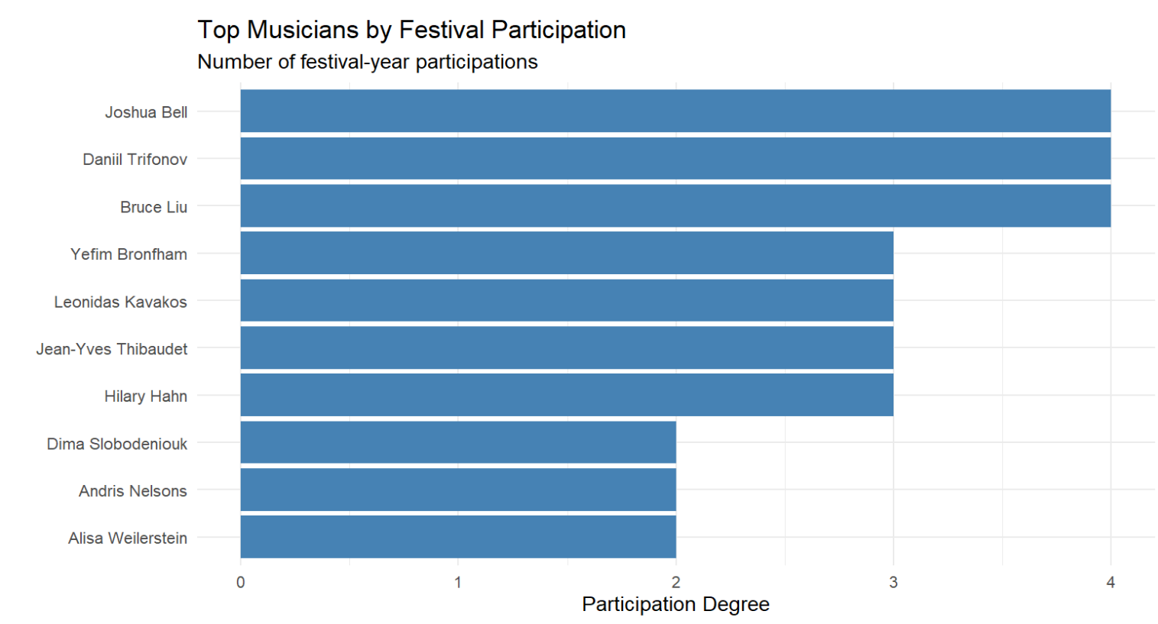
Modeling Collaboration and Participation Networks Across 3 Classical Music Festivals
Conor de Leeuw, Data Analytics and Computational Social Sciences
DACSS 790N: Social Network Inference
Abstract
Hypotheses
Results
Discussion/Conclusion
Significant musician side participation.
Instrument-family not statistically significant, suggests recurring participation.
Repeated involvement among small group of highly connected musician's shapes festival participation.
Positive gwb1degree indicates participation is concentrated among a small group.
Certain musicians appear across multiple festival-years
.
This project examines collaboration and participation patterns within elite classical music festival networks using ERGM and social network analysis. An initial one-mode musician collaboration network produced highly dense structures that complicated ERGM estimation which motivated a shift toward a two-mode musician–festival participation framework.
Using guest artist rosters from major festivals including Aspen, Bravo! Vail, and Tanglewood, the project analyzes how repeated participation and instrument-based structure shape network formation. Results suggest that participation is concentrated among a relatively small group of highly connected musicians, highlighting the role of institutional embeddedness and recurring artistic communities in shaping elite classical music networks.
H1: Musician participation is concentrated among a relatively small group of highly active musicians across festival-years.
H2: Some festival-years attract disproportionately more musicians than others.
H3: Festival participation patterns vary across instrument families
.
Data/Methodology
Data:
2023 and 2024 Musician participation rosters from:
Aspen Music Festival
Bravo! Vail Music Festival
Tanglewood
Variables:
Musician
Instrument
Festival
Year
Network Construction:
Two mode network:
Mode 1 = musicians
Mode 2 = festival-years
Tie indicates musician participation in a festival-year
Methodology:
Degree centrality analysis
Two-mode ERGM
gwb1degree: dependency in participation structure
Participation concentration modeling
Figure 1: The two-mode network reveals concentrated participation among a relatively small group of highly connected musicians who repeatedly appear across multiple festival-years
Introduction
Classical music festivals operate as highly collaborative artistic environments.
Professional relationships influence performance opportunities, institutional visibility, and career advancement.
Prior studies of music networks just focus on institutional prestige.
Model musician participation across festival-years as a two-mode network.
Aims to demonstrate how repeated participation shapes artistic communities.
Research Question
Joshua Bell, Daniil Trifonov, and Bruce Liu demonstrated the highest levels of festival-year participation, appearing repeatedly across elite festival communities. This suggests recurring institutional involvement and reinforces the presence of highly connected artistic sub-networks within festivals.
What factors shape musician participation in elite classical music festivals, and do highly active musicians and festival-years produce concentrated two-mode network structures?
Network Term | Effect | Significance | Interpretation
gwb1degree | Positive Effect | P < 0.001 | Participation concentrated among highly active musicians
Instrument Family | Mixed effect | Not significant | Instrument type did not strongly predict participation.

